Slide 1



Shedding light on
DarkPatterns
Presented by: ByteBenders

Slide 2

Overview
Strategy/goal
About dark pattern
consequences
statistics
Next Project
Project features
Example case
Flow chart
Future advancement
Our team

Slide 3


Goal
To detect the dark pattern on the page Give the number of Dark patterns found and highlight them on the page.

Slide 4

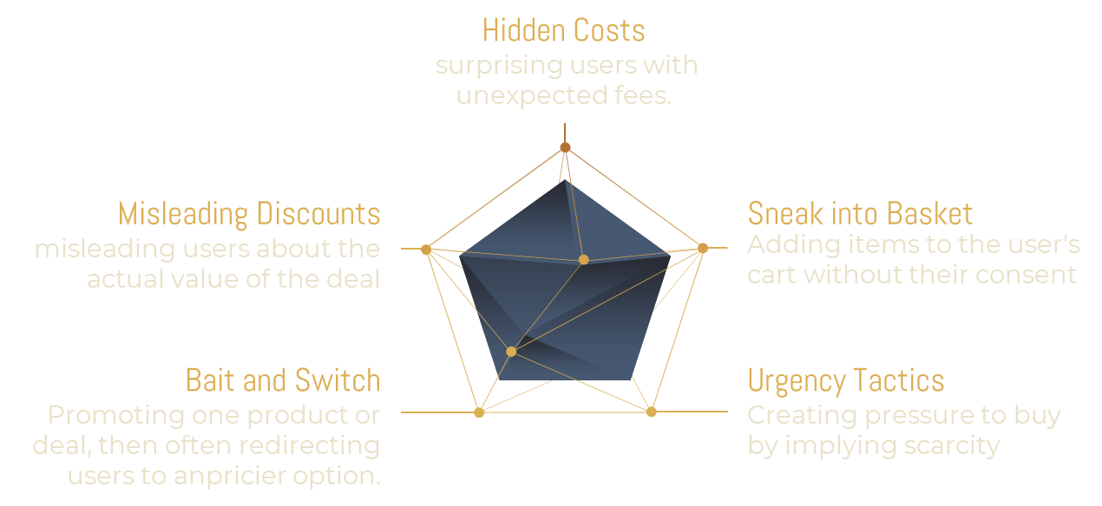
What are Dark pattern and their basic types

Slide 5




Consequences
User Manipulation
Dark patterns manipulate users into taking actions they may not want to take or making decisions that are not in their best interest.
Legal Risks
dark patterns may violate consumer protection laws or regulations
Ethical Concerns
It may damage the company's reputation

Slide 6






Project Features
01
02
03
04
Web extension
To make a interactive GUI for working on the project
Page analyzing function to detect the number of dark patterns fount on that page
Highlight the dark patterns on that page and show the type of it by hovering on the highlighted region
A chatbot to show that is it worth to buy this product at that particular time or not with some additional features

Slide 7
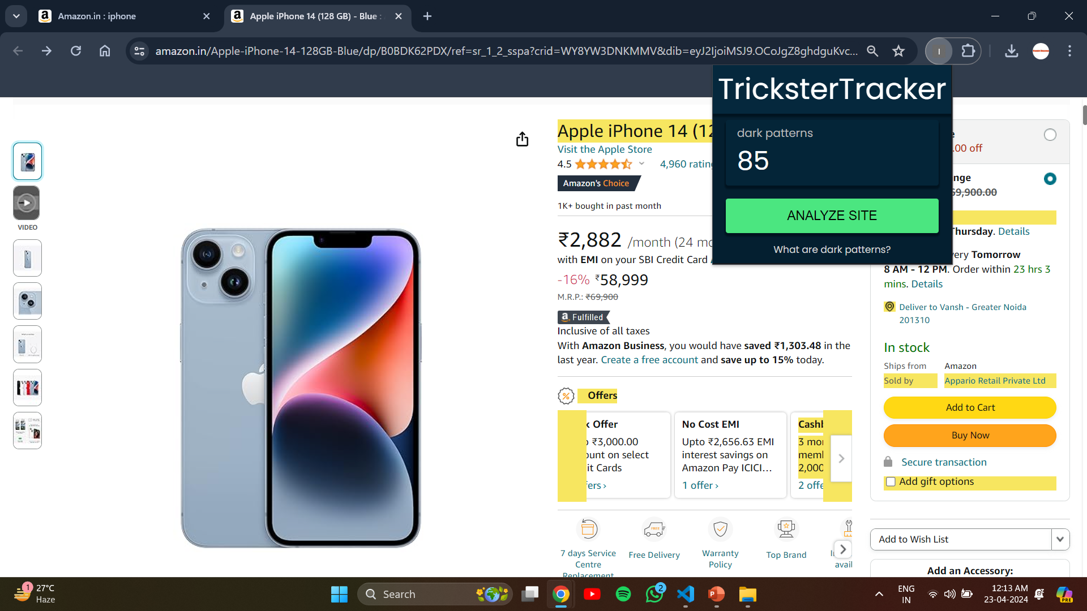
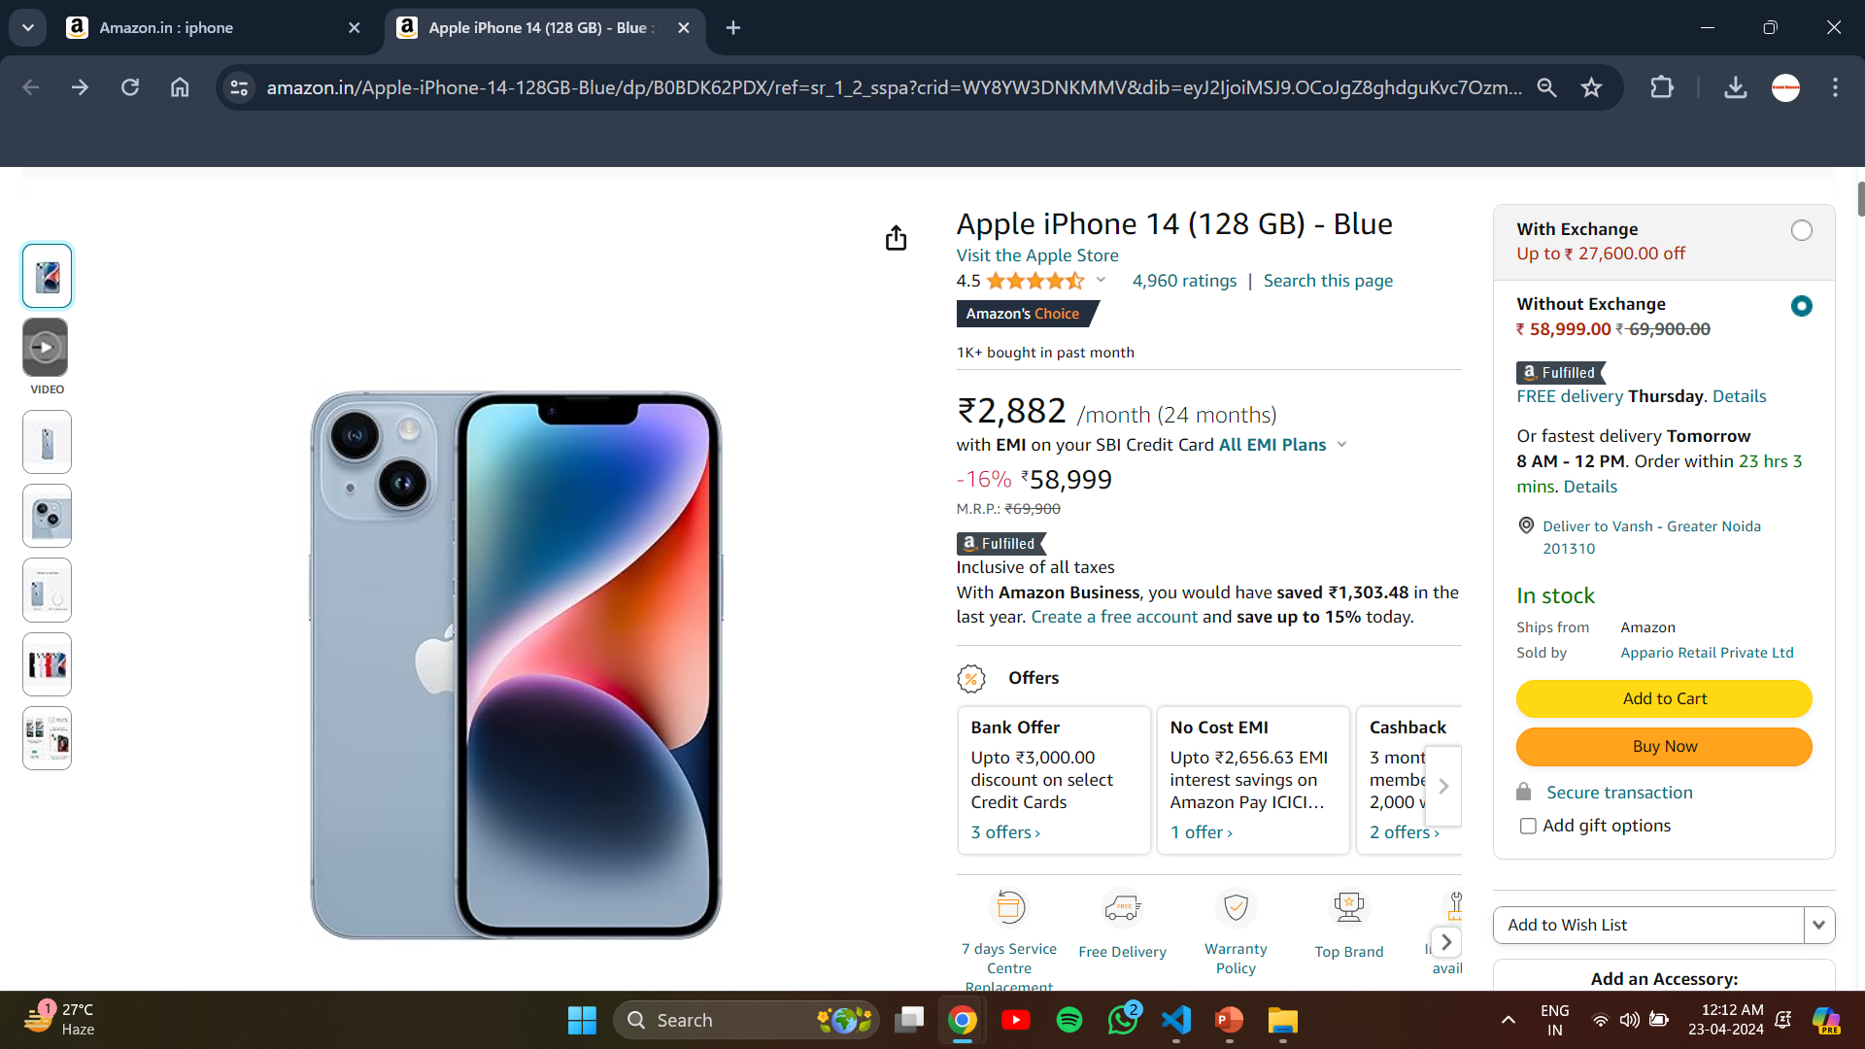
Example case
After
Before

Slide 8
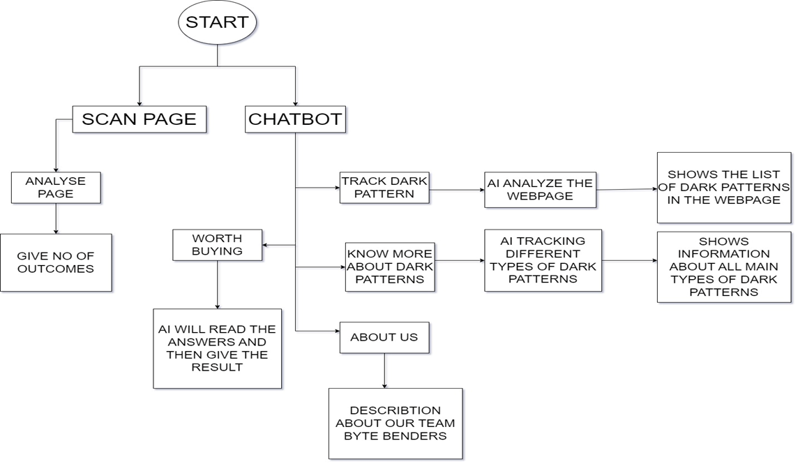

Slide 9
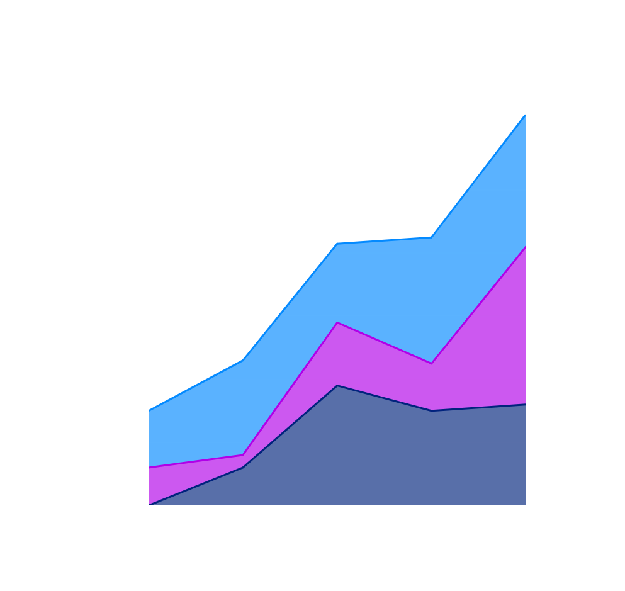
Statistics
5%-30%
Approximate impact of dark patterns on prices in one day
95%
Top 1000 websites globally used them

Slide 10

FUTURE ADVANCEMENTS
Advanced Dark Pattern Detection
Enhanced AI-Powered Chatbot
Multi-Platform Support
Data Privacy and Ethics
User Empowerment Tools

Slide 11
Our team
Aditya Bharadwaj
Vansh
Satyam Varshney
Nishant
Robin Kumar

Slide 12
THANK YOU
For watching this presentation

